Slide 1
Constructor

Slide 2

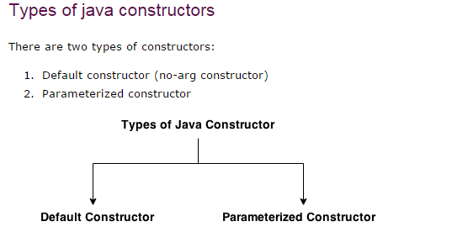
Constructor
Constructor is a special method that gets invoked “automatically” at the time of object creation.
Constructor is normally used for initializing objects with default values
unless different values are supplied.
Constructor has the same name as the class name.
Constructor cannot return values.
A class can have more than one constructor as long as they have different
signature (i.e., different input arguments syntax).

Slide 3
Defining a Constructor: Example
public class Counter { int CounterIndex;
// Constructor
public Counter()
{
CounterIndex = 0;
}
//Methods to update or access counter
public void increase()
{
CounterIndex = CounterIndex + 1;
}
public void decrease()
{
CounterIndex = CounterIndex - 1;
}
int getCounterIndex()
{
return CounterIndex;
}
}

Slide 4
Defining a Constructor: Example
public class Counter { int CounterIndex;
// Constructor
public Counter()
{
CounterIndex = 0;
}
//Methods to update or access counter
public void increase()
{
CounterIndex = CounterIndex + 1;
}
public void decrease()
{
CounterIndex = CounterIndex - 1;
}
int getCounterIndex()
{
return CounterIndex;
}
}

Slide 5
Trace counter value at each statement and What is the output ?
class MyClass {
public static void main(String args[])
{
Counter counter1 = new Counter(); counter1.increase();
int a = counter1.getCounterIndex();
counter1.increase();
int b = counter1.getCounterIndex(); if ( a > b )
counter1.increase();
else
counter1.decrease();
System.out.println(counter1.getCounterIndex());
}
}

Slide 6
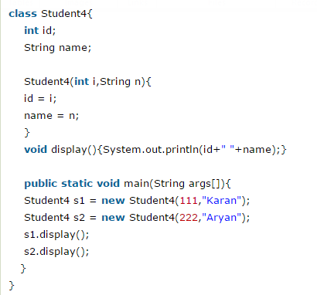
Java parameterized constructor
A constructor that have parameters is known as parameterized constructor.
Why use parameterized constructor?
Parameterized constructor is used to provide different values to the distinct objects.

Slide 7
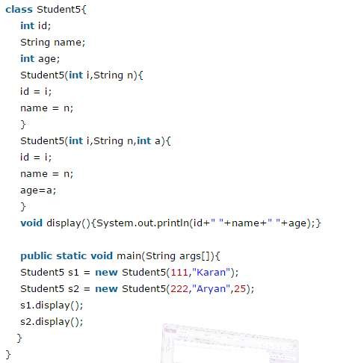
Constructor Overloading
Constructor overloading is a technique in Java in which a class can have any number of constructors that differ in parameter lists. The compiler differentiates these constructors by taking into account the number of parameters in the list and their type.
7

Slide 8
Multiple Constructors
Sometimes want to initialize in a number of different ways, depending on circumstance.
This can be supported by having multiple constructors having different input arguments.

Slide 9

Multiple Constructors
public class Circle {
public double x,y,r; //instance variables
// Constructors
public Circle(double centreX, double cenreY, double radius) { x = centreX; y = centreY; r = radius;
}
public Circle(double radius) { x=0; y=0; r = radius; }
public Circle() { x=0; y=0; r=1.0; }
//Methods to return circumference and area
public double circumference() { return 2*3.14*r; }
public double area() { return 3.14 * r * r; }
}

Slide 10

Initializing with constructors
public class TestCircles {
public static void main(String args[]){
Circle circleA = new Circle( 10.0, 12.0, 20.0); Circle circleB = new Circle(10.0);
Circle circleC = new Circle();
}
}
circleA = new Circle(10, 12, 20) circleB = new Circle(10)
circleC = new Circle()
Centre = (10,12)
Radius = 20
Centre = (0,0)
Radius = 1
Centre = (0,0)
Radius=10
10

Slide 11
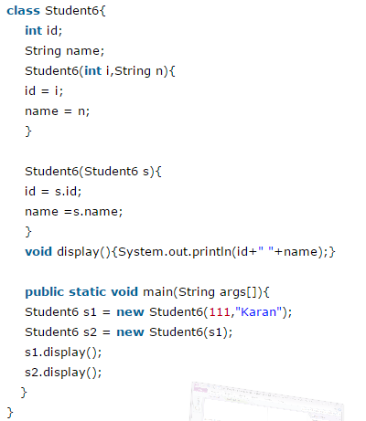
Java Copy Constructor
There is no copy constructor in java. But, we can copy the values of one object to another like copy constructor in C++.
There are many ways to copy the values of one object into another in java. They are:
By constructor
By assigning the values of one object into another
By clone() method of Object class
11

Slide 12
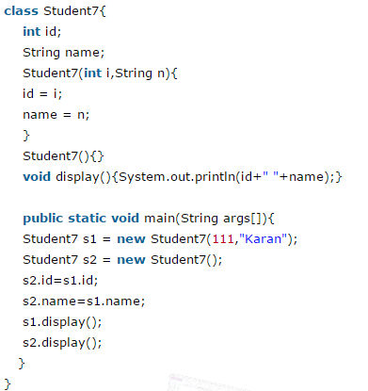
Copying values without constructor
We can copy the values of one object into another by assigning the objects values to another object. In this case, there is no need to create the constructor.
12

Slide 13
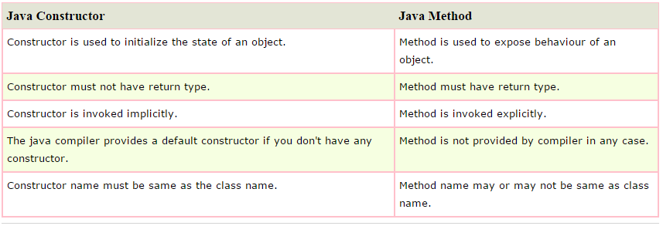
Difference between constructor and method in java
13

